Slide 1

Day to Day Operations of a 1:1 Deployment
Joanna Cook
Technology Director
jcook@eastnoble.net
@enmediagirl
Josh Walters
1:1 Manager
jwalters@eastnoble.net
@jwalters310

Slide 2
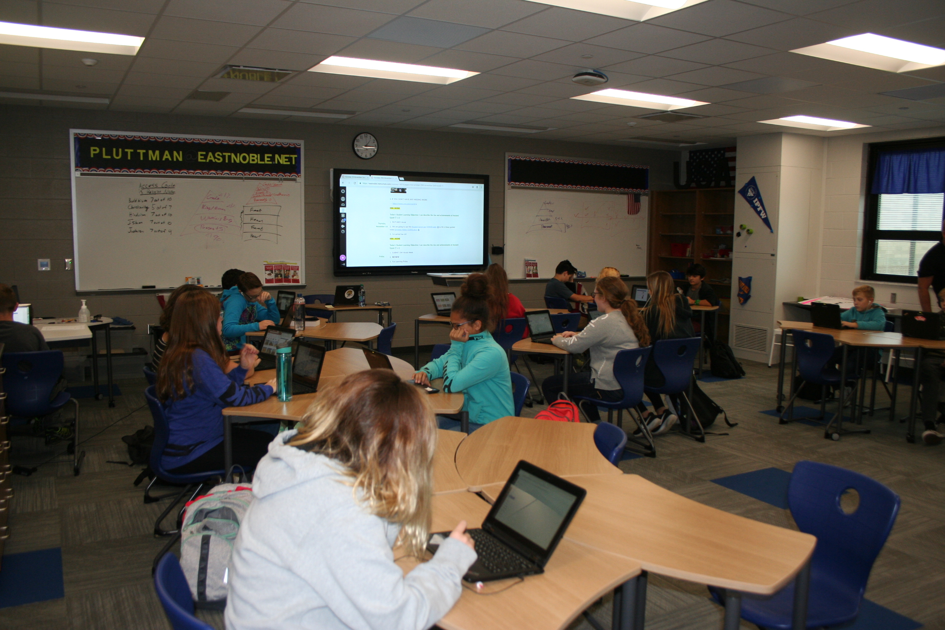
District Snapshot
East Noble School Corporation
PreK-12 public school corporation
8 schools (5 elementary, 1 middle, 1 high, 1 alternative school)
3,600 students
47% economically disadvantaged
3 Title I elementary schools
18.5% special education
Began a K-12 1:1 initiative in 2011
Devices:
  Grades K-4: iPads
  Grades 5-12: Lenovo Windows 10 Laptops

Slide 3

Brief Background
Discussion began Winter 2010
Toured other 1:1 Schools
Began Network Upgrades and Wireless Installation January 2011
Held multiple public meetings to inform parents of what was happening (VERY IMPORTANT)
Replaced staff desktop devices with laptops in May 2011
Piloted student deployment with staff's children June 2011
Deployed 5th-12th grade student machines first week of August 2011
K-4 students received devices on 1st day of school
Hired Peer Coaches for staff training Summer 2011
Switched K-1 students from iPods to iPads after two years

Slide 4
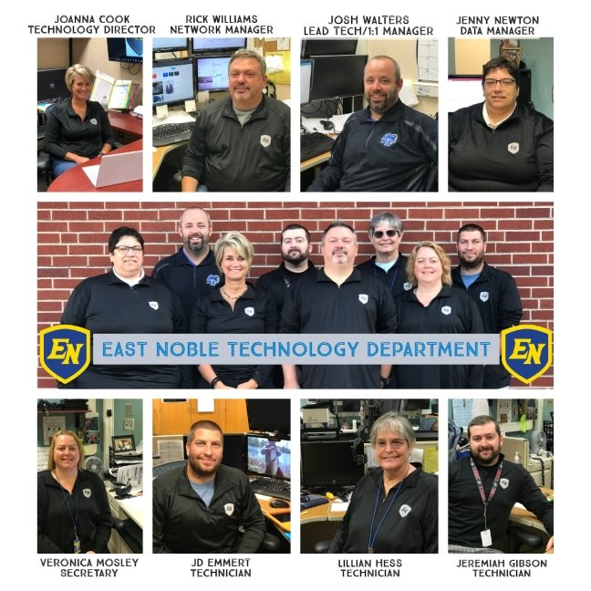
Technology Staffing

Slide 5

Technology Staffing for Teacher PD
PROVIDING ONGOING SUPPORT IS A NECESSITY!

Slide 6
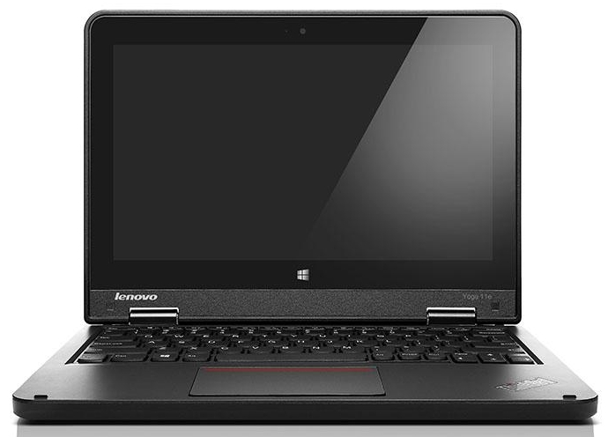
What Devices Do We Provide?
  5-12 students use a Lenovo Yoga 11E running Windows 10.
    Will always purchase a touch device
  K-4 students use an iPad
  Originally K-1 students started with iPods, but quickly realized they were too small to be used effectively

Slide 7
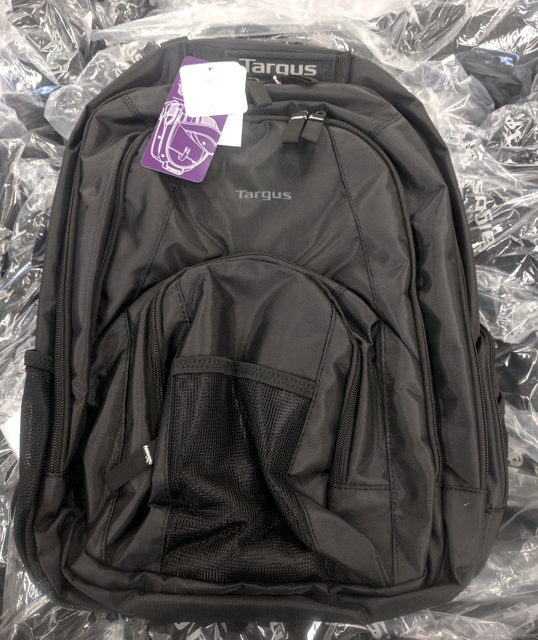
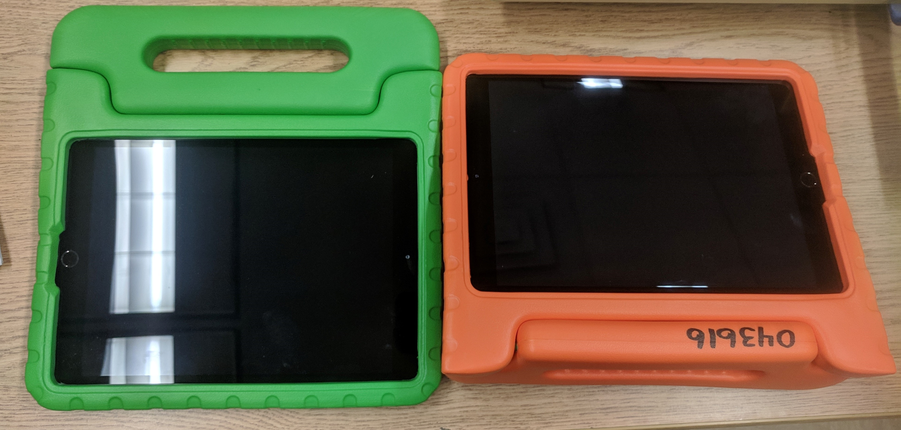
Backpacks & Cases Provided
  Laptop students receive
  a Targus CVR600 laptop bag
  (can use their own)
  iPad students receive an HGD foam
  handled case. Different color every year to distinguish device.

Slide 8
How Do We Pay for Devices?
In the first year, devices were purchased on 1 to 4 year leases based on the grade level of the student getting the device.
  The majority of the yearly costs came out of book rental.
Worked our way out of leasing 5th and 9th grade machines for four years.
Through careful budgeting, starting last year, all devices were purchased outright with no lease needed.
Book rental does not pay for the entire cost of the machine; the remaining balances are paid out of the General Fund/Instructional Materials.

Slide 9
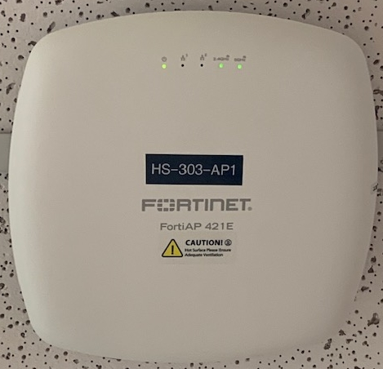
Network Infrastructure
  Fortinet Fortigate Firewall
  Fortinet Switches
  Fortinet FortiAp 421E Access Points in every classroom now. Started out with Cisco, and 2 APs for every 3 classrooms.
    Coverage is great for all classrooms, adding some APs in hallways for some areas
  Bandwidth is now at 1.5gbs.

Slide 10
Life of a Device
  iPads are on a five-year rotation. They are issued out to Kindergarten students and are used through the end of their 4th grade year.
    Issued new charging block and cable in Kindergarten to use for the 5 years
  Laptops are issued to 5th and 9th grade students and they use them 4 years.
  At the end of their 8th and 12th grade years, students are offered the option of purchasing their device.
    Devices that aren’t purchased
      Laptops are offered to staff first, and the remainder sold on eBay
      iPads are sold to a reseller in a lot.
        Asset Refresh has been our best reseller we have dealt with to date

Slide 11
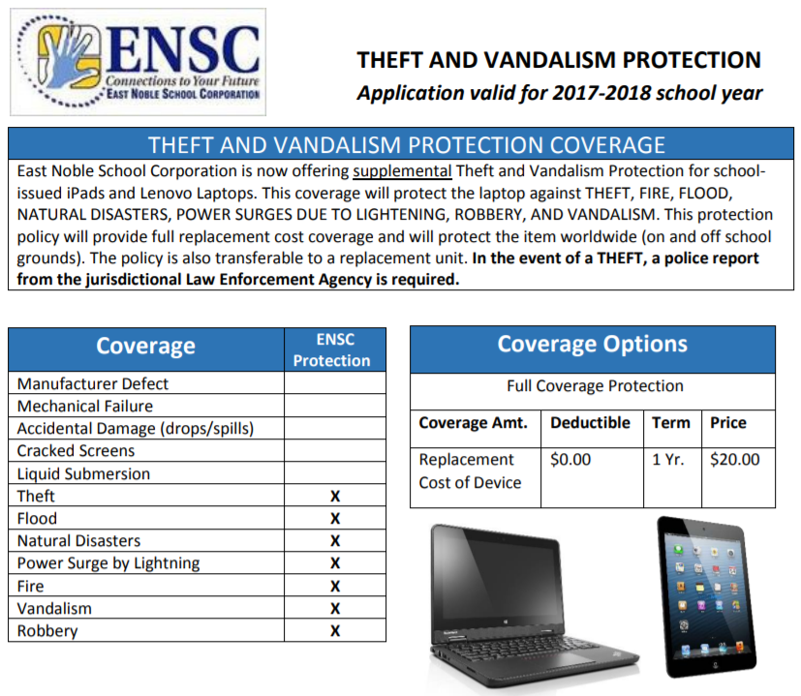
Damage Protection
  All Lenovo devices carry a 4-year Accidental Damage Plan on them.
    We are Self-Maintainers with Lenovo
  All iPads are self-insured for their 5 years in circulation for accidental damage
  We offer a voluntary $15 a year theft/vandalism self-protection option to anyone who has a device K-12
    If theft is reported, we require a copy of the police report
    before replacing the device.
  We do not have GPS tracking on our laptops.
    $$$$$

Slide 12
Loaner Devices
  5-10 laptops available as loaners at our elementary buildings
  30 laptops available as loaners at our middle and high school buildings
    Current loaner laptops at elementaries are older Windows 10 tablet teacher devices loaded with same software as student machines.
    High School and Middle School are now using Chromebooks as loaner devices. (HS just started last week)
    We increase loaner pools as needed should parts get backordered or other shortages
  iPad loaners come from the tech department as we have to set them up for individual student use before distributing. They are older model iPads than are currently being circulated (testing using Chromebooks as loaners for elementary students for easier deployment).

Slide 13


Google or Microsoft? BOTH!
  Microsoft
    All E-mail is through Office 365
    All Windows devices have Office 365 Pro installed on them
    SharePoint for staff work sites
    OneDrive is official staff/student file storage
  Google
    G-Suite is enabled for all users
    No e-mail accounts through Google
Teachers and students are able to choose whichever platform serves their learning purpose the best based on the activity they are doing.

Slide 14
Inventory and Ticket Tracking
  All inventory is handled through Destiny Asset Manager as part of our Destiny Library Management Program.
    Easier for our media assistants as they are familiar with the program
    Previously used Spiceworks, but switched due to the slowness of Spiceworks
  Help tickets for devices that need to come to us are also tracked through this system

Slide 15
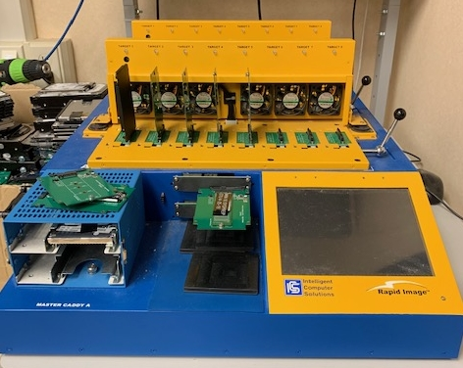
Setting Up Devices
  Inventory devices when unboxing (Seton inventory tags & Destiny Resource Manager)
  Hard Drive duplicator to image physical drives and swap out drives in machines
  Laptops go in bags and iPads go in cases
  Students are full administrators on their devices. We do restrict some things via group policy.

Slide 16
Deploying Devices, Grades 5-12
  Freshmen receive machines before school starts at Freshman Orientation.
    Receive name label when entering cafeteria as their ticket to a device, then proceed to techs at tables who apply name label to device and check out to student. Students then sign-in to their devices while in café.
      If they are not fully registered or owe money, they do not get a name label or a device that day unless they complete registration/pay their fee.
  5th graders receive their devices on the first day of school.
    Technicians take a list of 5th grade students who are fully registered and label and check out their device and then assign it to the building crate by class.

Slide 17
Deploying Devices, Grades K-4
  1st-4th grade students receive their device from the previous year in their classroom on day 1.
    They are not issued a new charging cable, charging block, or case.
  Kindergarten students get their iPads setup and checked out to them in our warehouse and then crated by building/teacher to receive on the first day of school.
    They are issued a new charging cable and charging block to use for the 5 years they will be using an Apple device
  Preschool students use a classroom set of iPads that stay with the teacher in the classroom.

Slide 18
Student Account Creation
  Parents register students online using Powerschool Parent Portal through InfoSnap
  Secretary/Guidance finalize registration and assign classes
  Tools4Ever then assigns username and password for students
  Tools4Ever then creates the Active Directory account and applies group membership based off of class information in Powerschool
    Process is set to run every 24 hours
    Office licensing is assigned based off of the groups they are put in
  A report is ran on new students so we know who needs a device setup
  After verifying there are no outstanding charges, a new device is created and sent to the media center to be handed out to the student.

Slide 19
Taking the Devices Home
  ENSC declares an eLearning Day for all weather-related cancellations, so all K-12 students must take devices home.
  6th-12th grade students take their devices home every night and keep their devices over the summer.
  5th grade students use their devices in the classroom the first 2 weeks of school to learn device care and basic digital citizenship. After two weeks they are allowed to take them home every night and then keep them over the summer.
  1st-4th grade students take their devices home the first day of school. Devices begin staying at school again with approximately 1 week of school left in the year.
  Kindergarten students use their devices in the classroom for the first month of school and then are allowed to take them home. Devices begin staying at school again with approximately 1 week of school left in the year.
  Preschool students' iPads stay in the classroom.
  If students owe money, their devices stay at school.

Slide 20
Filtering Devices
  We use Fortinet’s Forticlient to filter windows-based devices. Staff and students are filtered the same at school as at home with this.
  For iOS devices, we push a global proxy pac file to filter students
    It was decided that they didn’t want the young students to have to type in their credentials to get online
  YouTube is allowed via restricted mode
  We do not block streaming media or games.
  Added Gaggle for e-mail and document scanning this February
    Reports go directly to principals, counselors, and SRO

Slide 21
Filtering Devices
  Any requests from staff to know what a student is doing at a certain time must go through administration.
  Parents requesting limited access must contact an administrator or counselor for the building to put that request in. Then they notify tech to restrict the student and for how long.
    No-internet restriction (limits to educational sites only)
    No-internet total-lockdown (limits internet and also restricts installing anything on their machine or using USB drives)
    No e-mail restriction
    No Skype restriction (this is Skype for Business that we provide)

Slide 22
Questionable Content
  If there is believed to be inappropriate items on a device, teachers are to report the device immediately to administration. Administration then retrieves the device and depending on what was reported proceeds with investigation.
  If police need to be involved, admin just closes laptop and fills out investigation form and then contacts IT and SRO for laptop to be examined.
  If it is just school discipline, admin contacts IT to begin investigation on it.

Slide 23
Printing
  Staff devices get a Papercut Printer installed based on their OU in Active Directory. They then release jobs at the printer to print. This eliminated a huge waste of paper.
    Still some main office printers for secretaries to use
  Students can e-mail staff things they need printed, or we have a few machines in our library at HS for students to print from.
    Was a USB printer, but they broke it twice
  No printing is setup for iOS devices. Students submit work via SeeSaw or through email when needed.

Slide 24
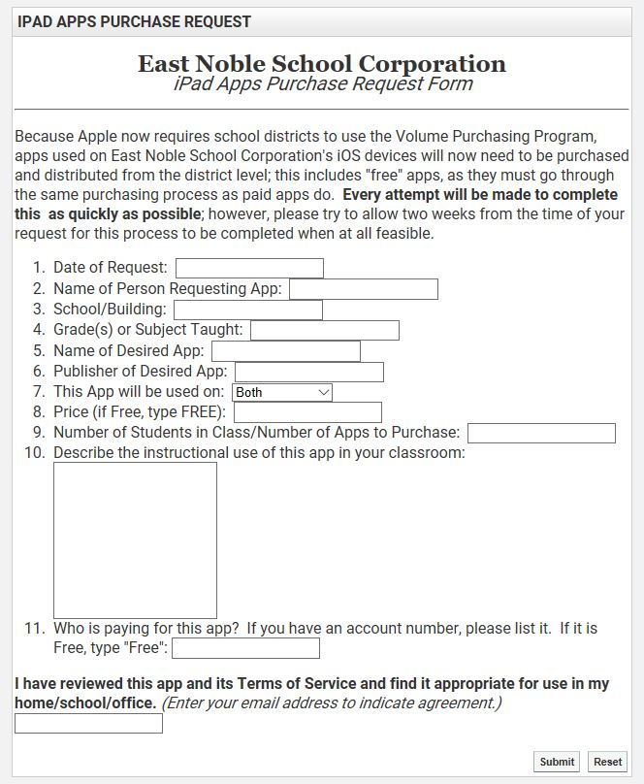
Managing iOS Devices
  Started out using Airwatch and had multiple issues with it. Some were Airwatch and some were Apple.
  Switched to JAMF last school year to manage devices, and so far, only minor issues.
  When staff want an App deployed to student iPads, they must fill out an app request form.
  Apps from one year carry over to the iPads the next year.
  Deployed based on Active Directory group. (Building & Grade)

Slide 25
Managing Windows Devices
  Students are full admins on their devices, so if a program is needed they can just install it at that time.
  They are responsible for keeping their device updated with Windows and Lenovo updates.
    Some kids are better than others at this.
  We do have restrictions available via group policies to limit this:
    No-internet restriction (limits to educational sites only)
    No-internet total-lockdown (limits internet and also restricts installing anything on their machine or using USB drives)
    No e-mail restriction
    No Skype restriction (this is Skype for Business that we provide)

Slide 26
Repair Process- Performance Issues
STUDENT BRINGS DEVICE TO LIBRARY WITH PERFORMANCE ISSUES
Problem is simple
Problem is fixable, but student will be without the machine for more than ONE HOUR.
Media assistant investigates issue and determines if problem is fixable
Problem is fixable in a short time period, but it is determinied it will take more than a brief moment to fix.
Student does NOT receive a loaner and returns to class.
Media assistant fixes machine and delivers to student
FOR LAPTOPS ONLY, student fills out a Loaner Agreement to receive a loaner and goes back to class.
Machine is repaired by media assistant or tech staff
Student brings loaner machine back to the library and receives original machine back.
Media assistant quickly fixes the issue and the student returns to class

Slide 27
Repair Process-Physical Damage
Student brings device to library with physical damage
Damage deemed accidental by media assistant
Student signs and fills out Accidental Damage Form
Damage deemed negligent, intentional, or questionable
Device is taken to administration with form attached
Media assistant enters ticket into Destiny Resource Manager
Device turned in to Tech Staff
Tech Staff evaluates damage and orders parts for repair
Parts arrive, and the device is repaired by the technician
Technician closes Destiny ticket and returns device to the media assistant to return to the student
Media assistant fills our Student Repair/Damage Form
Device is taken to Tech Staff to determine approx. cost to repair and costs/parts are written on Damage form
Administration interviews student to determine the situation behind the damage
Administration determines damage is accidental
Administration determines damage is negligent or intentional
Administration contacts parent to inform of damages and costs to repair
When contact is made, device is returned to tech department and is held until payment is received or payment plan is agreed upon
Device is returned to the Tech Staff to repair

Slide 28
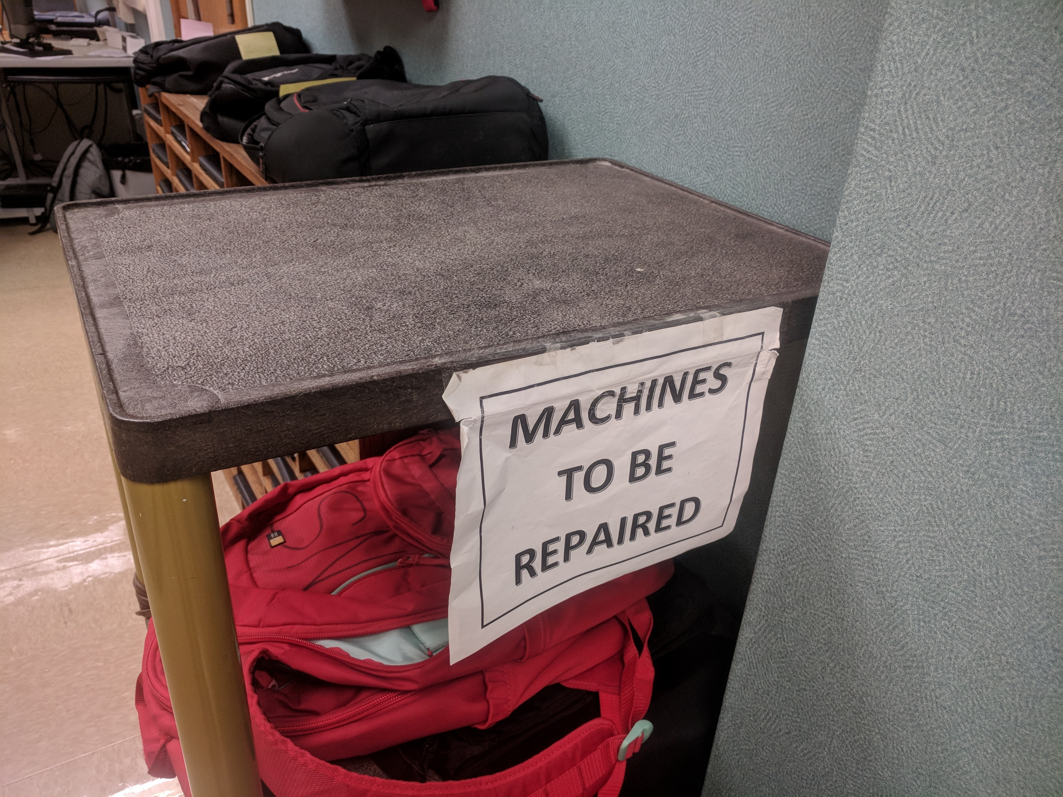
Handling Repairs that Require Parts
Machines come in and go onto the “Machines to be repaired” cart
As soon as a technician is available, they begin work on the machines on the cart by either fixing them or ordering parts for them from Lenovo.

Slide 29
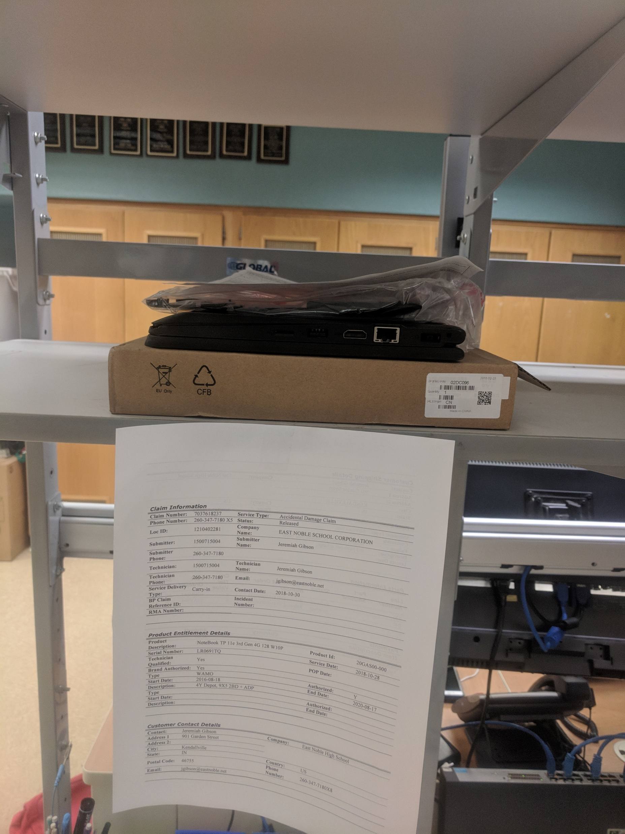
Handling epairs that require parts
3. Once a Lenovo claim has been filed, the claim ticket is printed and hung with the device on the shelf so parts can be distributed correctly.
4. Once all parts are in for a machine, technician repairs the machine and closes out the Destiny repair ticket for the machine

Slide 30
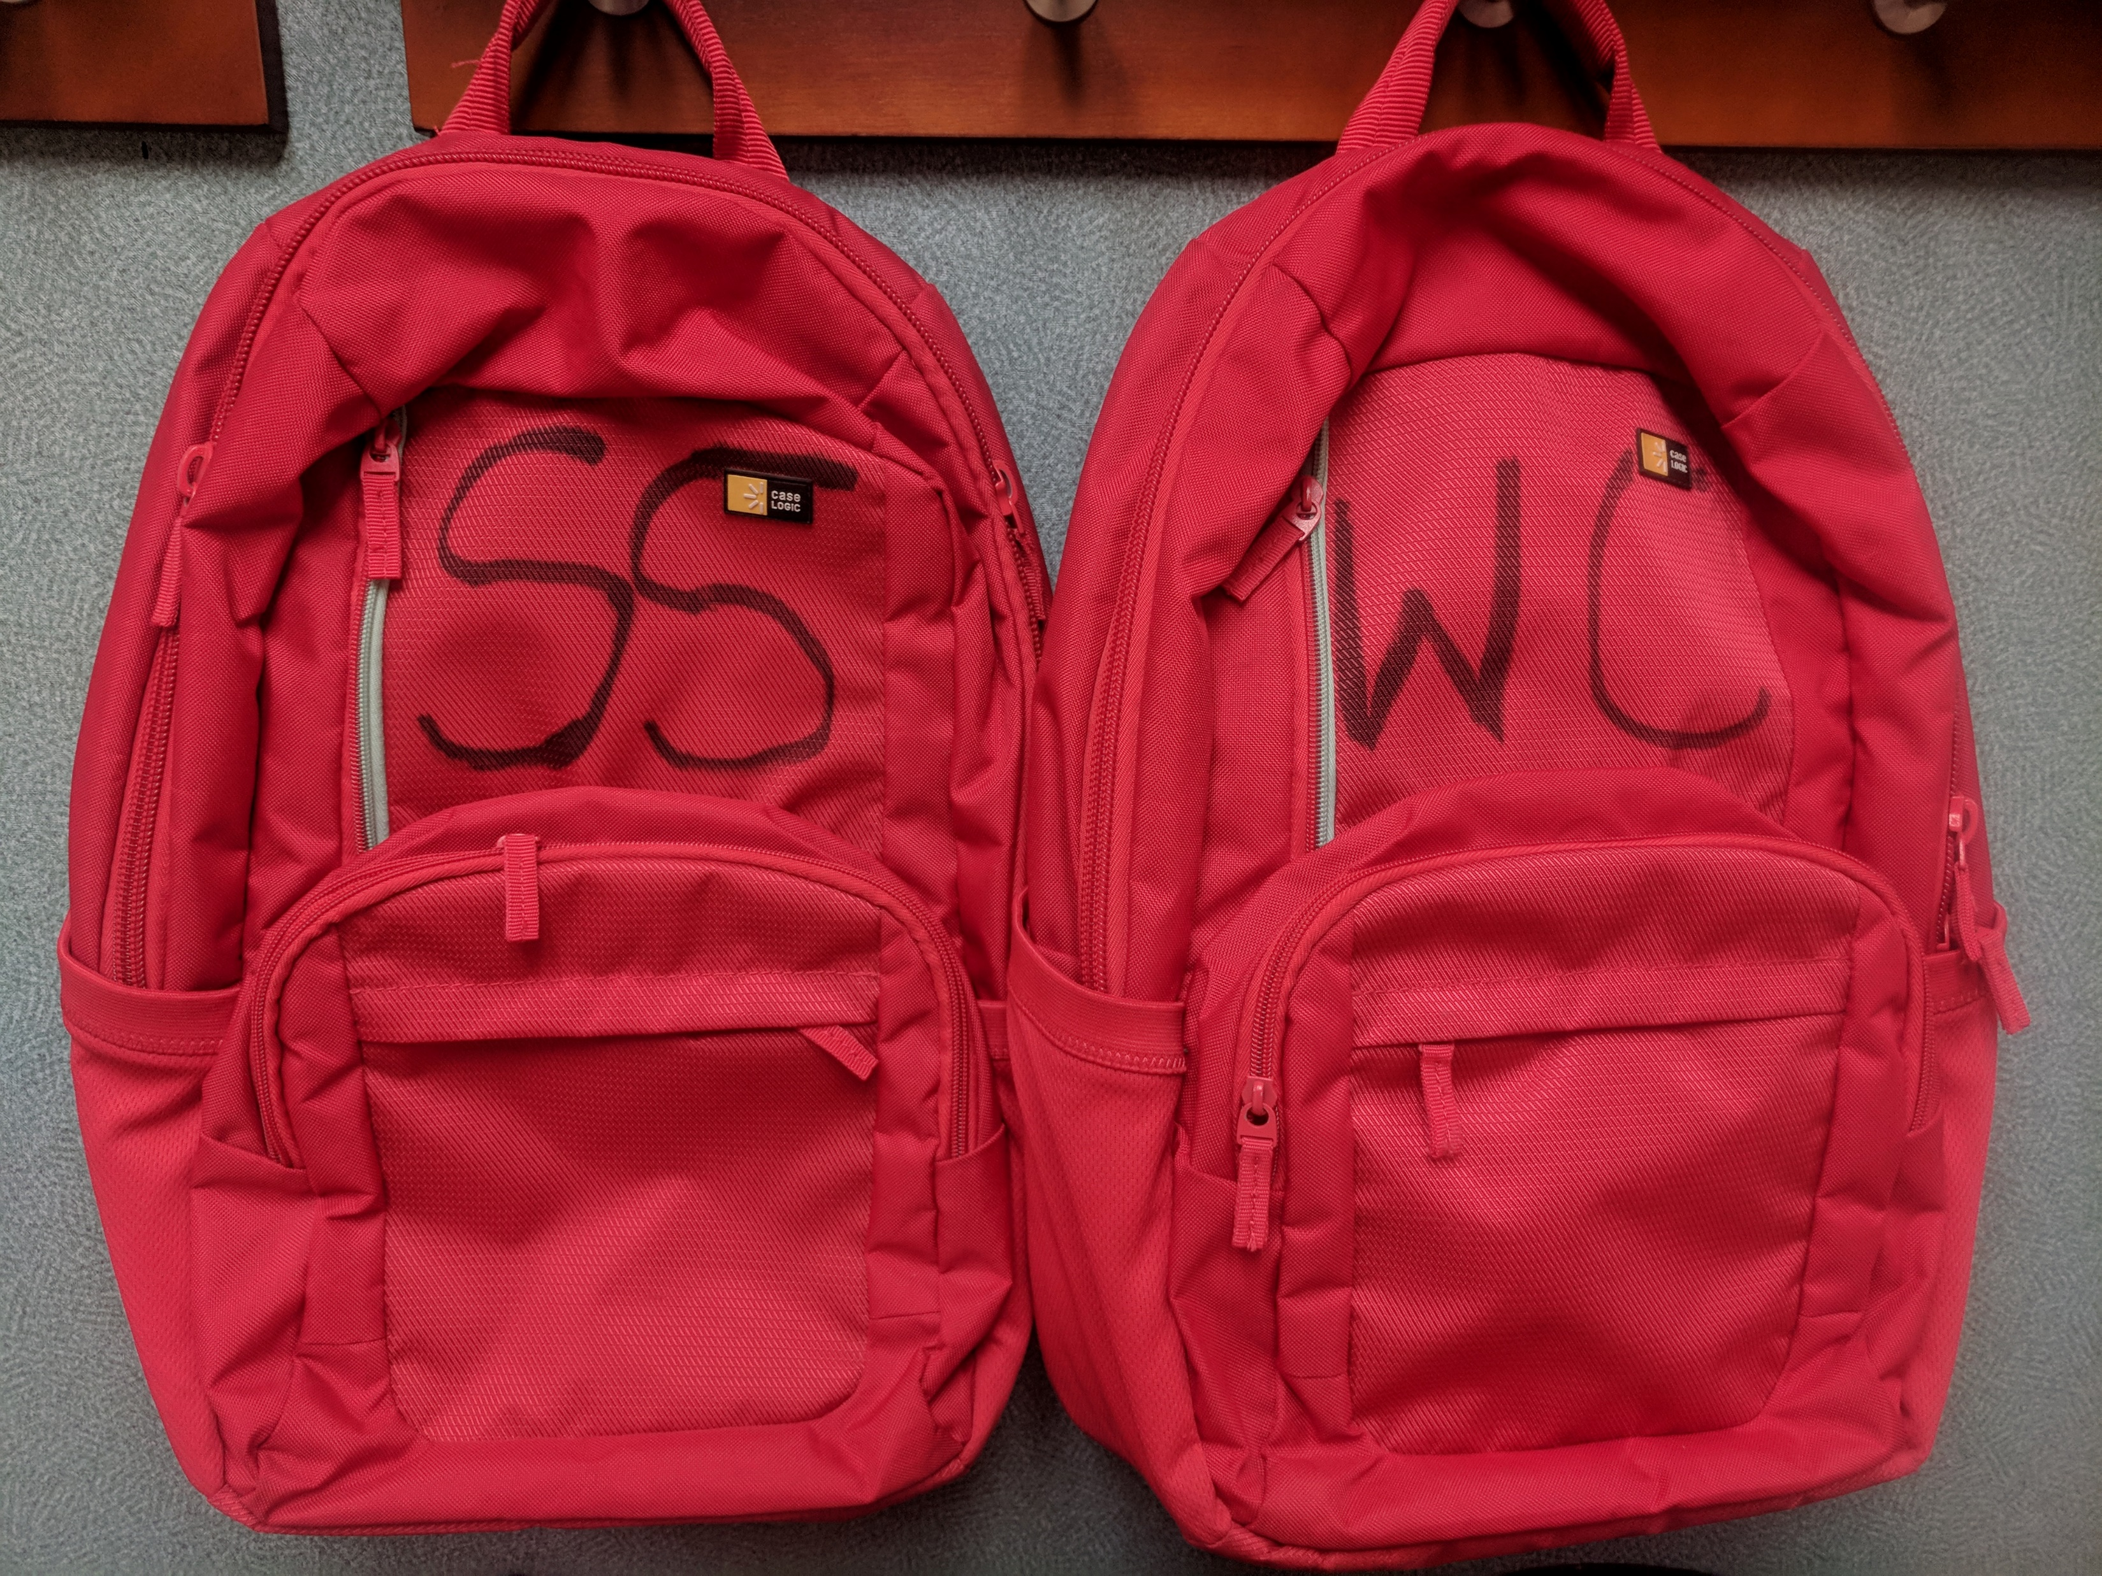
Handling Repairs that Require Parts
5. When machines are repaired, they go back into their red bags to be taken back to the buildings in which they belong.
6. Once at the correct building, the media assistants work to get the machine back to the students.

Slide 31
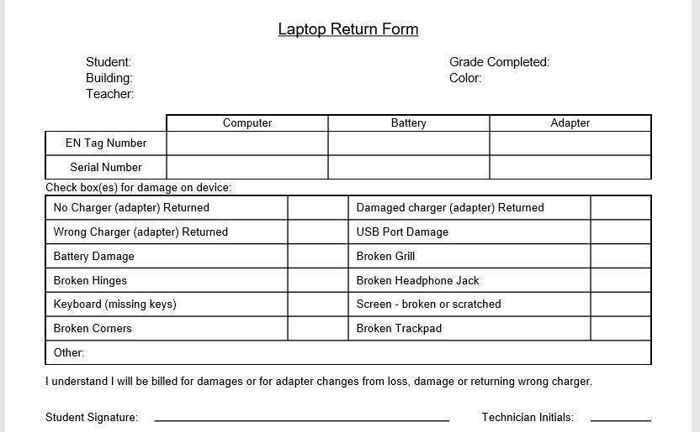
Collecting Laptops
  8th and 12th grade students return their machines one day before the last student day
    We print off collection sheets from Powerschool with student and laptop info on them.
    8th grade collection happens in the morning and 12th in the afternoon.
    Techs inspect devices and note damages or wrong devices.
    Students sign if there will be charges assessed on the device.

Slide 32
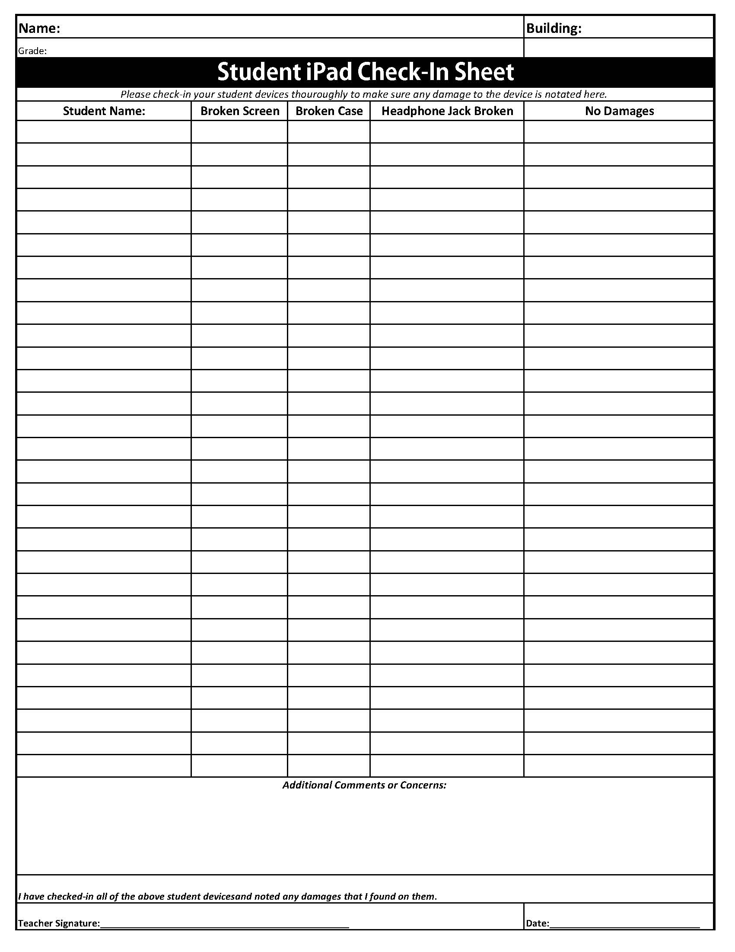
Collecting iPads
  K-4 teachers collect their iPads in class and fill out their collection form, then place the iPads in a crate and then into a central secure location for storage over the summer.
    Teachers are to report to the tech staff if they have damaged devices when they collect them
    We only collect the iPad and case; students keep the charging cable and block.

Slide 33
Invoicing for Intentional or Negligent Damages
  Parents are contacted by building administrators letting them know cost of damages.
  Once parents are contacted, we send invoice with instructions on payment.
  After 1 month, another invoice is sent out and letting them know it will be turned over to collections if not paid
  After 2 weeks of not hearing back, a 3rd invoice is sent letting them know that their charges will be turned over to collections.
  We wait another 2 weeks after this and then send to collections

Slide 34
Withdrawn Students
  When a student leaves the district, they return their machine to the media center, or main office of their building.
  Over the summer, withdrawing students return devices to the central office or high school office.
  If students withdraw and do not return their device, we contact parents to let them know they must return it or they will be billed for it.
  Some parents claim they didn’t know they had to return it.
    If they are still in the area, we send our SRO to knock on their door and ask for it
    If still can’t get device back, we start the invoicing process
    Testing pressing criminal charges for theft

Slide 35
E-learning Days
  If school gets closed for weather or any other reason, we switch to an e-learning day.
  10% of students reported not having internet at home
  High school teachers are required to have the days work posted on Canvas by 9:00 A.M.
    Students have 1 day after an e-learning day to turn in homework from that day.
  Middle school teachers are required to have the days work posted on Canvas by 9:00 A.M.
    Students have 3 days after an e-learning day to turn in homework from that day.
  Elementary teachers are required to have their work posted to Seesaw by 9:00 A.M.
    Students have 3 days after an e-learning day to turn in homework from that day.

Slide 36
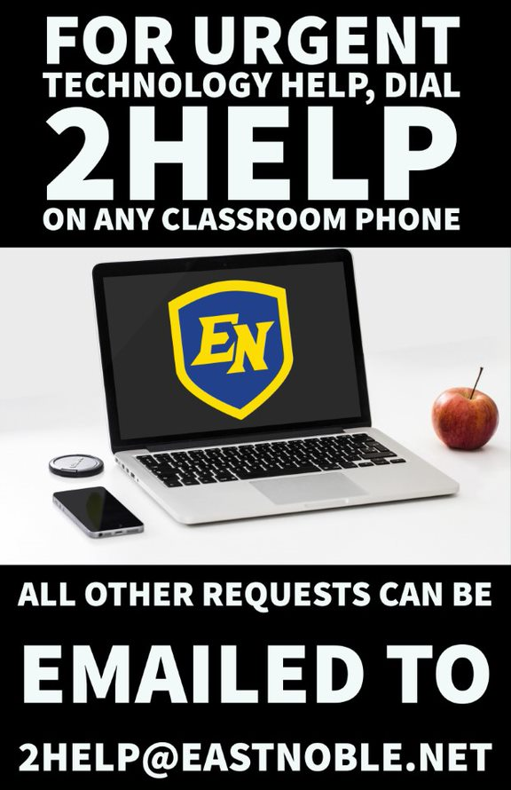
Support for Staff
  If not urgent, staff can email 2help@eastnoble.net and we will get to them as soon as possible.
  If URGENT help is needed, staff can call 2help from their phones and it rings every technician desk in the corporation for help.
  If we need remote assistance to help with a problem, staff can go to 2help.eastnoble.net and we can then connect remotely to them and help troubleshoot issues.

Slide 37
Staff Devices
  Staff are offered an optional protection plan for $35 per device (1 time cost for life of the device) that they have with a $50 deductible should they need to use it.
  If damage happens while working in classroom with students, we repair device for no charge.
  If damage happens offsite or negligently, staff are responsible for replacement costs to repair the device, or the $50 deductible if they had the protection plan.

Slide 38
Staff Professional Development
  On E-learning days, we offer 2 Pop-Up PD sessions that last 20-30 minutes for staff to tune in via Skype for Business on topics relating to current needs.
  Online Knight in Training courses are available 24/7 via Canvas for staff to take.
    Over 70 different courses currently available
    Prizes offered for completing modules throughout the year
  Technology coaches facilitate trainings within their buildings based on their building needs
  BrightBytes data is used to drive PD for the district
  Cyber Security training via MediaPro
  Offer summer trainings when new equipment is implemented
    Staff Laptops, Interactive Panels, etc.

Slide 39
Misc Other Things
  Network Monitoring- WhatsUp https://www.ipswitch.com/network-monitoring
  File and E-mail backups- Backupify https://www.backupify.com/
  Camera System- Truvision Navigator https://www.interlogix.com/navigator
  Copier Management- Papercut https://www.papercut.com/
  E-mail Archiving- MimeCast https://www.mimecast.com/
  E-mail/File Scanning- Gaggle https://www.gaggle.net/
  SIS- Powerschool https://www.powerschool.com/
  Lunch Program- MealMagic https://www.mealmagic.com/
  Phone System- Mitel https://www.mitel.com/
  Transportation- Versatrans https://www.tylertech.com/products/versatrans
  Financials- New World https://www.tylertech.com/products/new-world-erp

Slide 40
Day to Day Operations of a 1:1 Deployment
Joanna Cook
Technology Director
jcook@eastnoble.net
@enmediagirl
Josh Walters
1:1 Manager
jwalters@eastnoble.net
@jwalters310

